Slide 1

Team Details
Team name:
Team leader name:
Problem Statement:

Slide 2

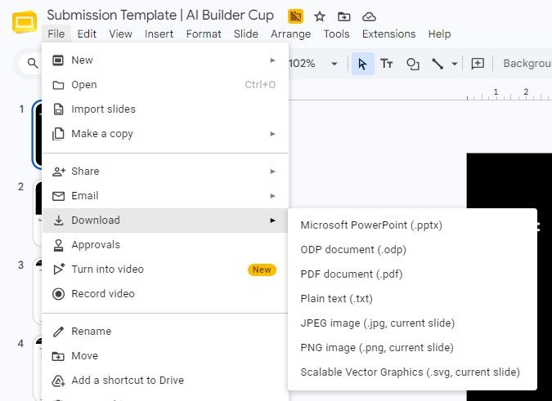
Note: Please download this template to make your edits and submit the ﬁnal version.
To download, go to File > Download > Microsoft PowerPoint (.PPTX). Kindly refrain from sending edit requests.

Slide 3
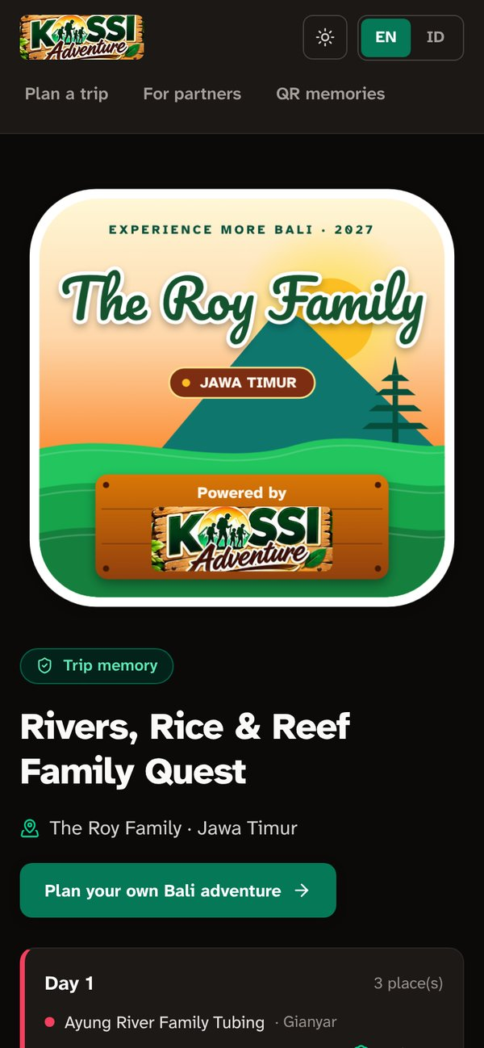
Brief about the idea
Experience More Bali 2027
An AI-powered tourism ecosystem on KOSSI Adventure (Indonesia Tourism Initiative): one shared platform with two front doors.
Scan a QR on a T-shirt →
the family’s trip memory page opens on any phone, no app needed.
Travelers choose, they don’t type: tap Bali regions and experiences, get a ready basket of local partners, and Gemini arranges the days on a Bali map with real driving times and warnings.
Partners (desa wisata, warung, homestays, guides) sign up in a minute, answer tap menus about their business and digital channels, and get an AI support plan plus grounded marketing copy.
Memory objects connect offline and online: every family and partner gets a sticker, printed on T-shirts, hats and bags with a QR code that opens their trip memory page.
Trust built in: AI answers are grounded in partner facts and schema-validated, and the KOSSI team verifies partners in batches before the ✓ badge appears.

Slide 4
Opportunities
How it is different
Booking sites sell big hotels; we route travelers to small local businesses and give those businesses AI tools they don’t have.
Planning by tapping, not typing: regions → experiences → basket → days.
Phygital: a printed sticker / T-shirt with QR links the trip back online.
Partners are verified by the KOSSI team, not just self-listed.
How it solves the problem
Travelers: realistic day plans (drive times, boat crossings, far-apart warnings) → a more satisfying trip.
Partners: the A–G digital-status grid shows where each needs help; the AI plan turns that into steps they can do this week.
Ecosystem: one shared directory joins fragmented local players; discounts and bundles drive cross-selling.
USP
Grounded, verifiable AI: Zod schemas, plan repair, a quality guard, and an honest instant fallback.
Live streaming: users watch the AI think and write.
Memory objects + QR pages: the campaign keeps living after the trip.
Bilingual (EN / Bahasa), dark & light, WCAG 2.1 AA.

Slide 5
List of features oﬀered by the solution
For travelers
Sign-up → family sticker (name, home region, “Powered by KOSSI Adventure”)
Trip wizard: tap regions on a Bali map, pick experiences, basket auto-filled with partners
AI “Arrange my days”: streamed live, coloured routes on the map, drive-time warnings
Quick AI plan: a gamified family itinerary with missions
Memory gear: sticker on T-shirt / hat / bag with QR patch; order via WhatsApp or email
QR memory page for every trip
For partners
Sign-up → Strategic Partner sticker
Business profile by taps (A–E): type, products, discount, AI help, digital status A–G
AI support plan from the “Need help” answers
AI marketing studio: grounded profile, social copy, missions → publish
QR counter card and staff gear
Listing status: published → in review → verified
Platform & KOSSI team
Admin verification: checklist, batches, notes, history
✓ KOSSI Verified badge + “Verified only” filter
Instant planner fallback (works with no AI key)
Print-ready files (2000 px sticker + QR)
EN / Bahasa and dark / light mode
Accessible: keyboard, screen reader, reduced motion

Slide 6
Process ﬂow diagram or Use-case diagram
Traveler
1 Sign up
family sticker
2 Tap Bali
regions (map)
3 Pick
experiences
4 Basket of
local partners
5 Gemini arranges
days + map
6 Memory gear
+ QR page
Shared ecosystem partner directory + verification status (server store) · Gemini via Google Gen AI SDK · validated, streamed answers
Partner
1 Sign up
partner sticker
2 Tap menus A–E
(profile, digital)
3 AI support
plan (streamed)
4 AI studio →
publish listing
5 KOSSI admin
reviews batch
6 ✓ Verified badge
+ QR counter card
Inside step 5 (traveler): basket → Zod-validated request → Gemini streams JSON (thoughts + answer) → schema check → plan repair (every stop exactly once) → quality guard (if AI driving time > 1.5× the instant plan + 60 min, the instant plan is used, honestly labelled).
Dashed line: a published partner appears in travelers’ baskets at once as “Not yet verified”, and gets the ✓ badge after the KOSSI team verifies the batch.

Slide 7
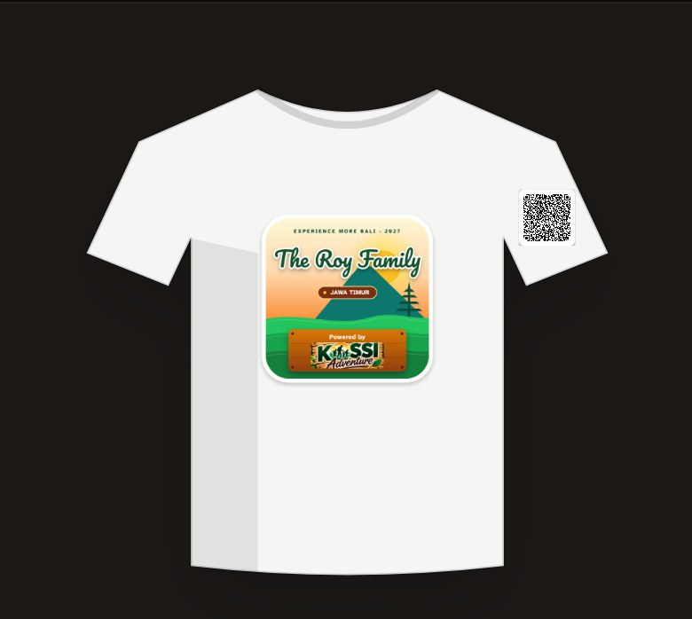

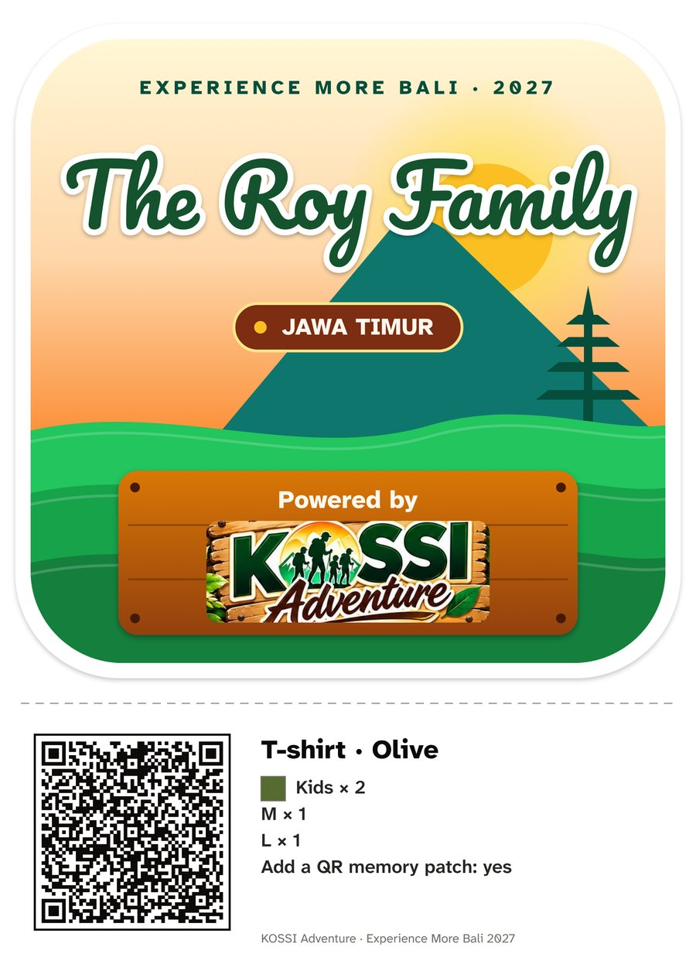
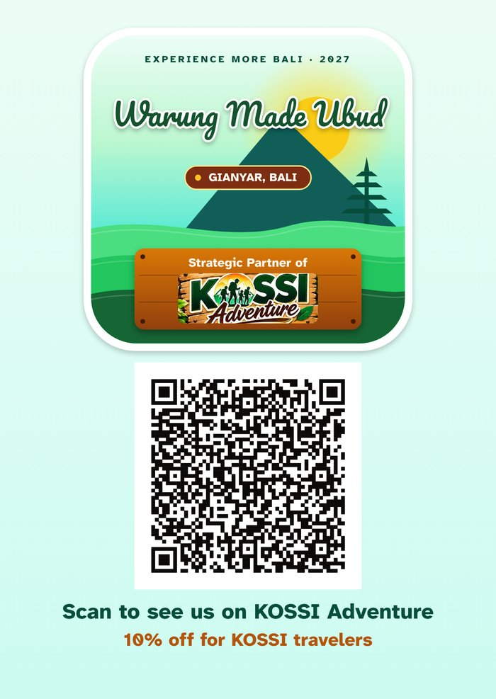
Wireframes/Mock diagrams of the proposed solution (optional)
Memory objects generated by the app: live product mock-ups, the print-ready file sent to the printing partner, and a partner’s counter card.
T-shirt mock-up (5 colours, QR patch)
Hat mock-up (drawstring bag too)
Print file: 2000 px sticker + QR + order
Partner QR counter card (A6)
Sticker: drawn on canvas in a 1000-unit design space, so the screen preview and the 2000 px print file are identical.
QR: the memory is packed into the link itself (no database lookup), error-correction level M for printed fabric; verified by decoding the QR from the print files.

Slide 8
Architecture diagram of the proposed solution
Clients
Traveler (web, mobile)
Partner (web, mobile)
KOSSI admin (/admin)
Anyone scanning a QR (/m/…)
In the browser
Session store (tabs keep state)
Accounts, theme, language: localStorage
Canvas sticker + QR rendering
Next.js 16 app (Node server)
Google Gemini
Gen AI SDK · gemini-3.5-flash-lite, fallback 3.1-flash-lite · JSON schema output · streaming with thoughts
UI · React 19 client components
Trip wizard · Bali SVG map · partner menus · merch designer · memory pages · admin
Partner store
Server JSON file, atomic writes, one writer at a time → Firestore-ready (one module)
API route handlers
Streaming (NDJSON): /api/traveler · /api/trip-plan · /api/partner-assistant · /api/partner-support
Directory: /api/partners (GET / publish)
Admin: /api/admin/session · /api/admin/partners (HMAC-signed cookie)
Printing partner
WhatsApp / email deep links with the order + memory link
Trust & safety layer Zod request validation · Zod → JSON schema for Gemini · partial-JSON live rendering · final schema check · plan repair · quality guard · thinking-setting fallback on 400 errors · retry on the fallback model · deterministic instant plans when AI is off or wrong (labelled honestly)

Slide 9
Technologies to be used in the solution
Frontend
Next.js 16.4 (App Router, Cache Components, standalone output)
React 19.3 · TypeScript 5
Tailwind CSS 4 · lucide icons
Atkinson Hyperlegible Next (accessible font) + Pacifico (sticker)
AI
Google Gen AI SDK (@google/genai 2.29)
Gemini 3.5 Flash-Lite, fallback Gemini 3.1 Flash-Lite
Structured JSON output (responseJsonSchema)
Streaming + reasoning summaries (thinkingConfig)
Data & validation
Zod 4: request and response schemas
NDJSON streaming protocol + partial-JSON parser
Server JSON store (atomic writes), Firestore-ready
HMAC-signed admin session cookie
Maps, media, print
Self-contained SVG Bali map from geoBoundaries ADM2 (CC BY 4.0), 9 regencies
HTML canvas sticker renderer (2000 px PNG)
qrcode library (QR on screen, gear, print files)
WhatsApp / mailto deep links
Planning engine
Haversine × 1.4 road factor at 28 km/h, +60 min boat
k-means day grouping with boat penalty
Nearest-neighbour day routes, travel warnings
Quality & tooling
Playwright end-to-end tests
axe-core accessibility audits (WCAG 2.1 AA)
ESLint · tsc · fake Gemini server for offline tests

Slide 10
Estimated implementation cost (optional)

Slide 11
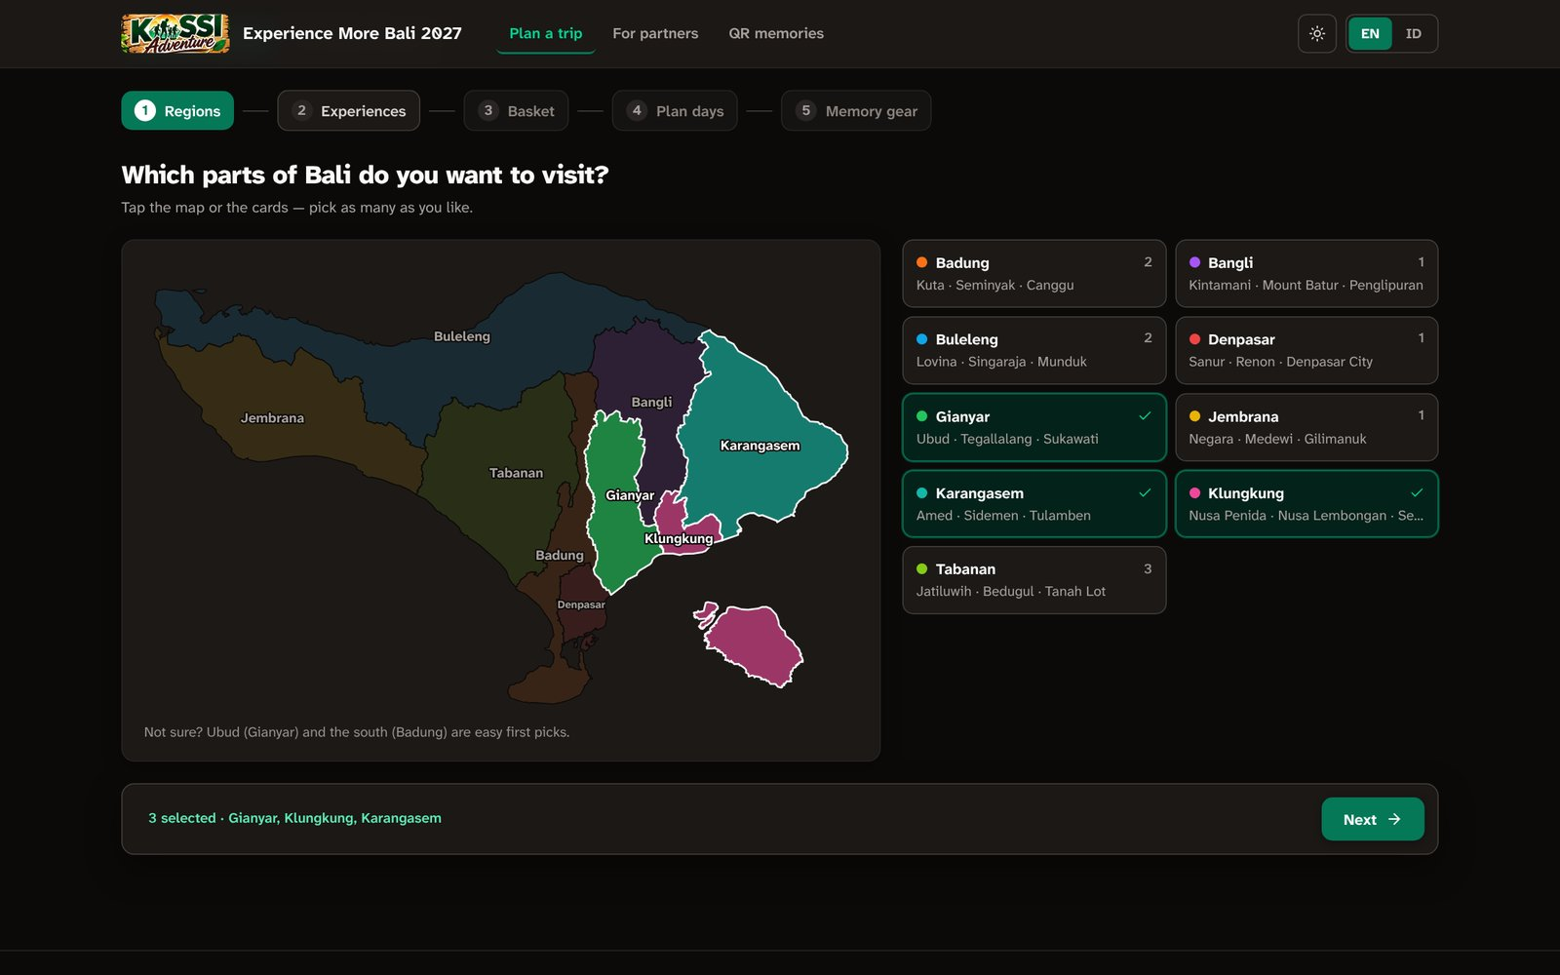
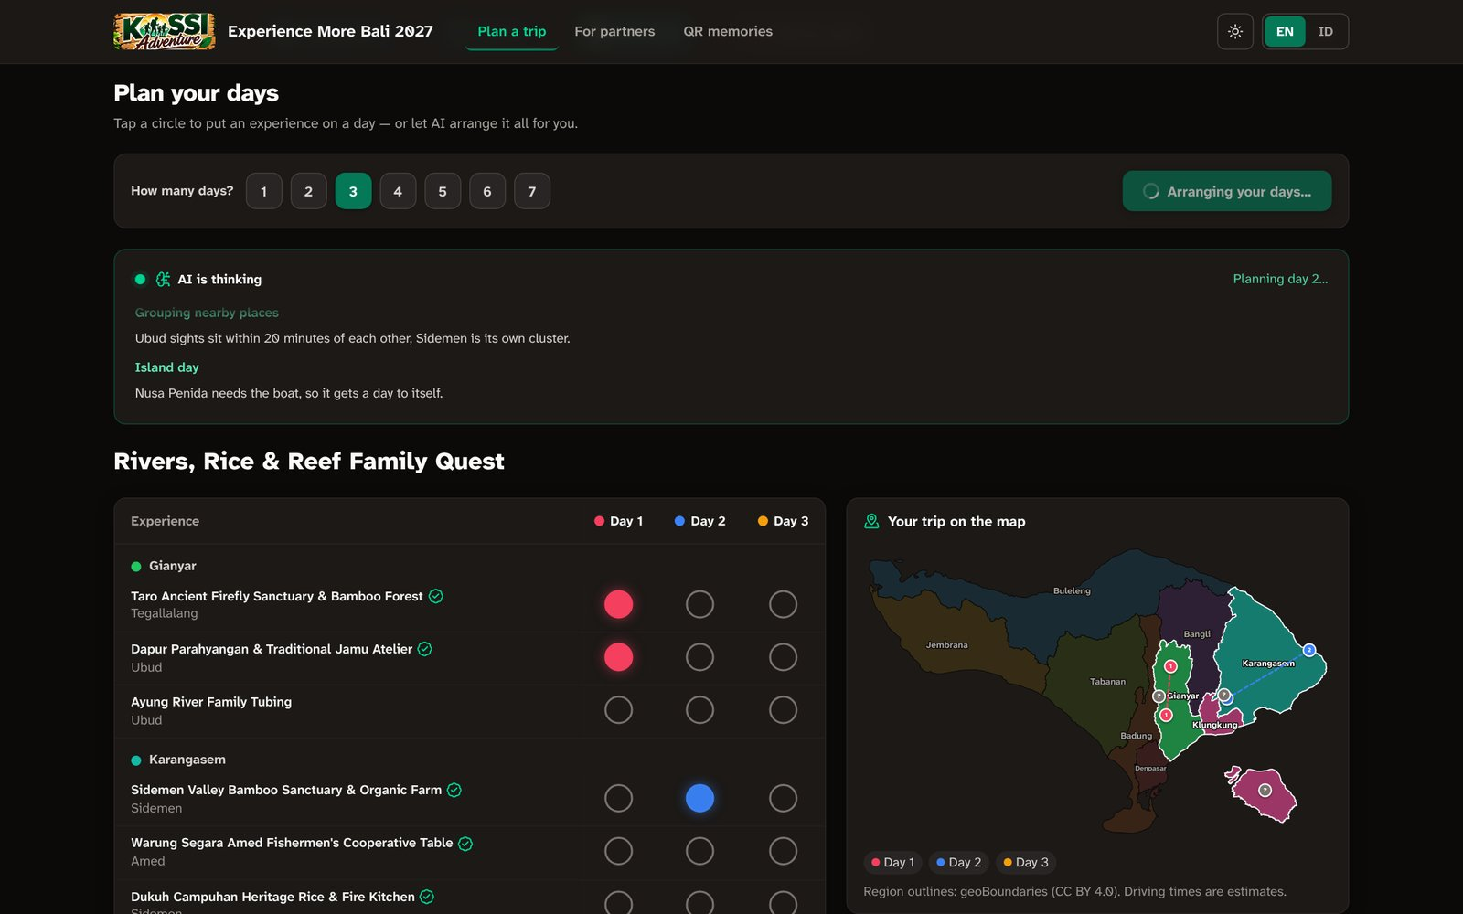
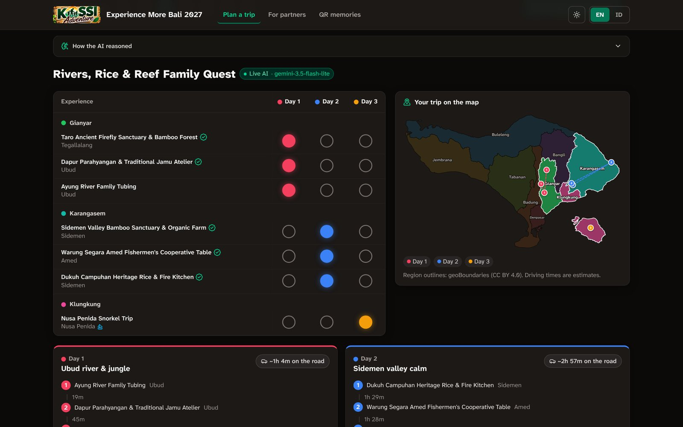
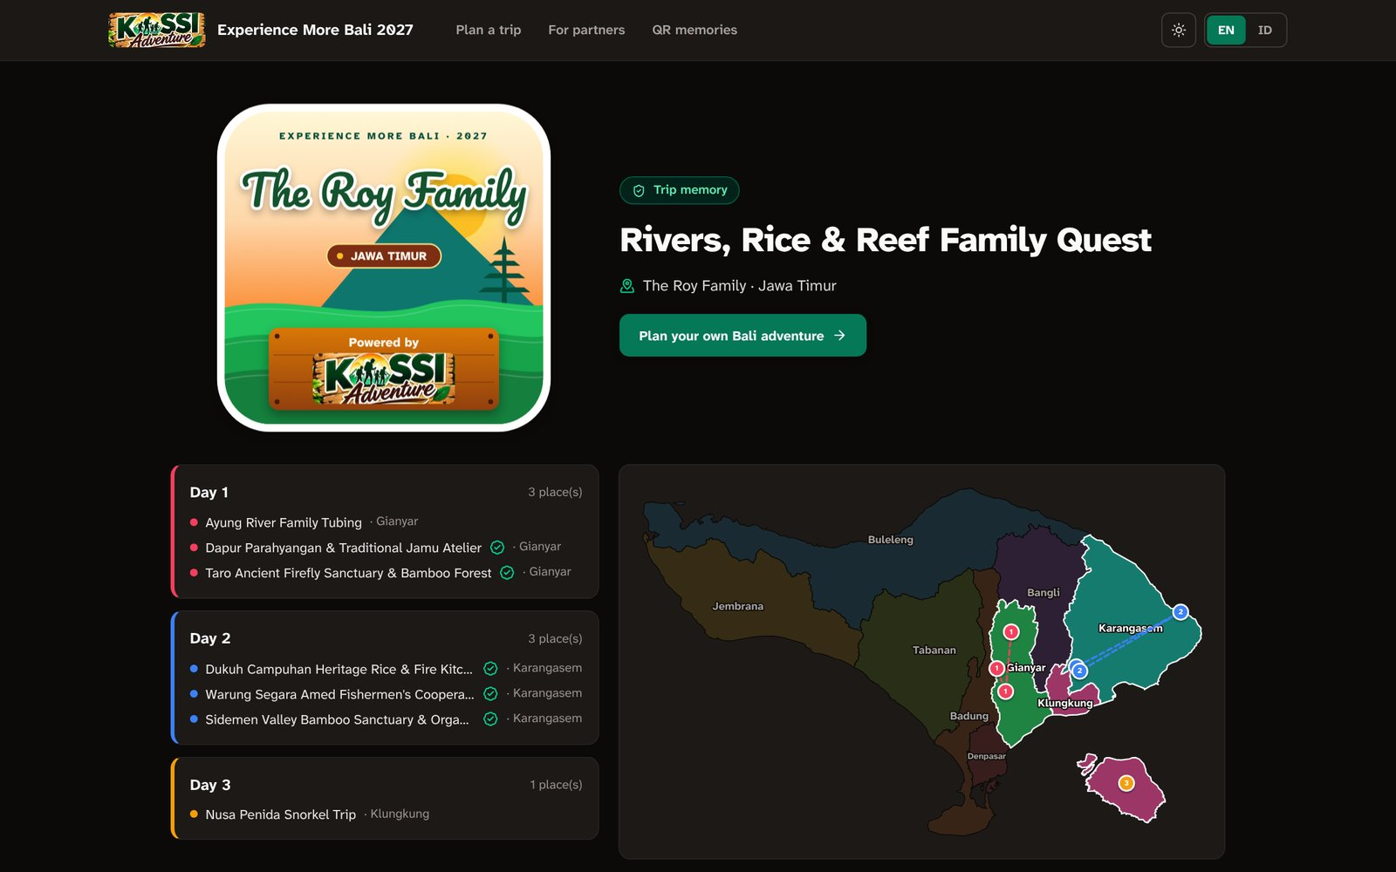
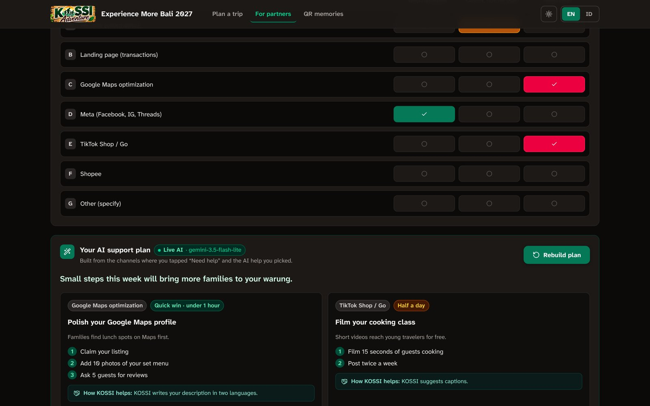
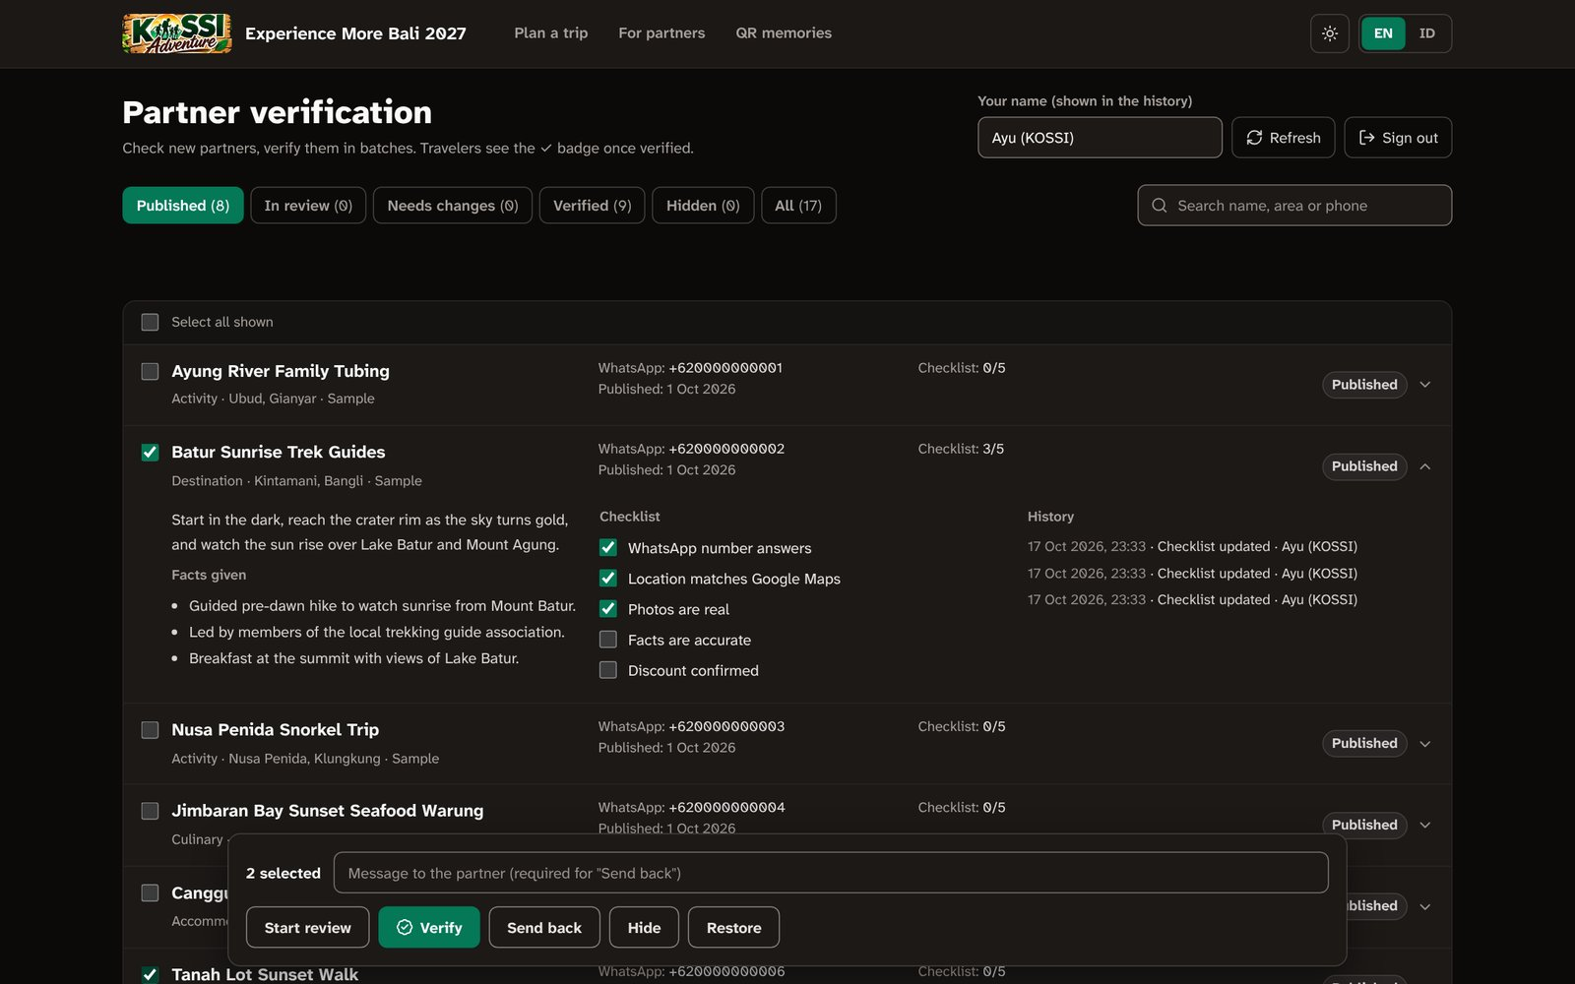
Snapshots of the prototype
1 · Tap regions on the Bali map
2 · AI streams the plan live
3 · Days, routes and drive times
4 · QR memory page
5 · Partner AI support plan
6 · KOSSI admin verification

Slide 12
Prototype Performance report/Benchmarking
0
accessibility violations
axe-core, WCAG 2.1 AA, 17 screens in dark and light mode
0.2 ms
instant trip planner
17 stops into 7 days (k-means + routes), used when AI is off
57 µs
per live UI update
partial-JSON parse of each streamed chunk (691 updates)
QR v10
memory link, 198 chars
57×57 modules, error correction M; decoded from print files
Reliability tests (fake Gemini server)
AI plan accepted, validated and repaired (missing stop placed on the nearest day)
Clumsy AI plan rejected by the quality guard → shorter instant plan
Primary model down → automatic retry on the fallback model
Broken JSON → honest fallback, no invented partners
Model rejects thinking settings (400) → simpler settings, cached
Page load (local production build, Chromium)
Landing: first byte 53 ms · DOM ready 178 ms · loaded 262 ms
Traveler / partner / admin pages: DOM ready under 80 ms
Speed changes: Flash-Lite model, minimal thinking, 25–60 s timeouts, and streaming — users see the first words within seconds instead of waiting for the whole answer
Phone width: no horizontal scrolling on any screen (390 px)

Slide 13
Additional Details/Future Development (if any)
Next (pilot in Bali)
Move the partner store to Firestore; individual admin accounts with roles
Photo and video uploads to QR memory pages (Cloud Storage), organised like a library
Order tracking with the printing partner, online payment
Partner insights: QR scans, trip inclusions, traveler types (“backyard” data)
Later (campaign growth)
Traveler credentials: verified adventure badges (nature, culture, culinary) — a “LinkedIn for adventure”
Sell authentic trip photos and videos online
Discount vouchers and destinations across Indonesia; a new creative campaign every year
Partner bundles and cross-selling suggested by AI

Slide 14
Provide links to your:
GitHub Public Repository
Demo Video Link (3 Minutes)
Final Product Link

Slide 16

Google Cloud
i i?-É

